Slide 1
Framework for “Hit Level Data” processing
Speed
Scalability
Solution is using AWS EMR which utilizes high performing Spark engine to process big data.
As solution is using AWS Serverless services (S3, Lambda, SNS and EMR) which scales automatically, it provides scalability out of the box.
CI and CD
Provided solution is using GitHub, Terraform and Circle CI which can speed up the entire deployment cycle.
Simplicity
Solution provided is easy to use by the developers as Python is the main language used.
Flexibility
Opportunity to integrate and customize with the existing AWS tech stack as desired.
Unit Test cases are part of CI CD process to minimize prod errors.

Slide 2






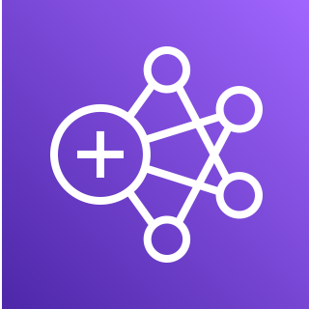

Technical Architecture Design
CloudWatch Logs
SNS Topic / Notification
Submit Job
S3 Raw Zone
Event Notification
Pre-Process Lambda
EMR
S3 Pre-Zone
Event Notification
Post-Process Lambda
S3 Processed Zone
IAM Roles

Slide 3



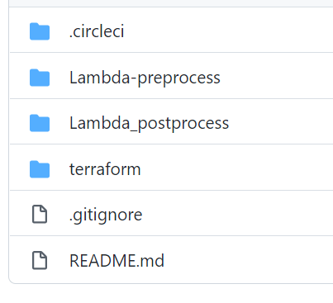
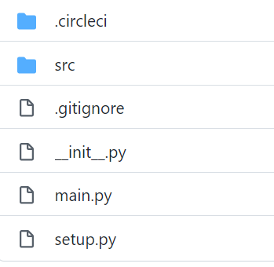
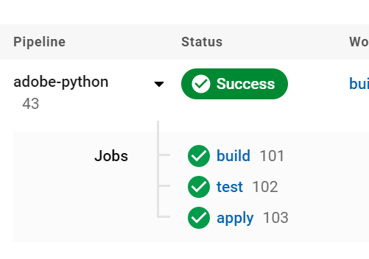
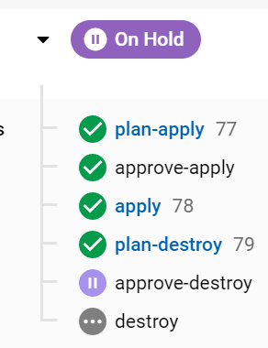
Continuous Integration and Delivery
Git push
Third-party Git repository
Trigger Build
Deployment
Provisioning
AWS Cloud
Git users
Terraform
GitHub Repo
Circle CI Pipelines
Deployment Script
Lambda Script
Provisioning Script

Slide 4
Technology Stack
What
AWS:
S3
Lambda
EMR – PySpark
Cloud Watch
IAM
SNS
Dev Ops:
GitHub –
https://github.com/atewari5kw7i9/adobe-iac.git -- Repo to provision S3 bucket, Lambda and SNS
https://github.com/atewari5kw7i9/adobe-python.git -- Repo to deploy python code to S3 bucket.
Terraform – For writing Infrastructure as code
CircleCI – For Deployment pipeline
Language:
Python

